Slide 1
Use of Differential Evolution for Graph Colouring
Scott Richmond-Wood

Slide 2
Introduction
So, my project was to use Differential Evolution to attempt to solve the 3-GCP (Graph Colouring Problem) for a number of graphs.
Today, we’ll explain the problem, differential evolution, modifications I needed to make, and the results.

Slide 3
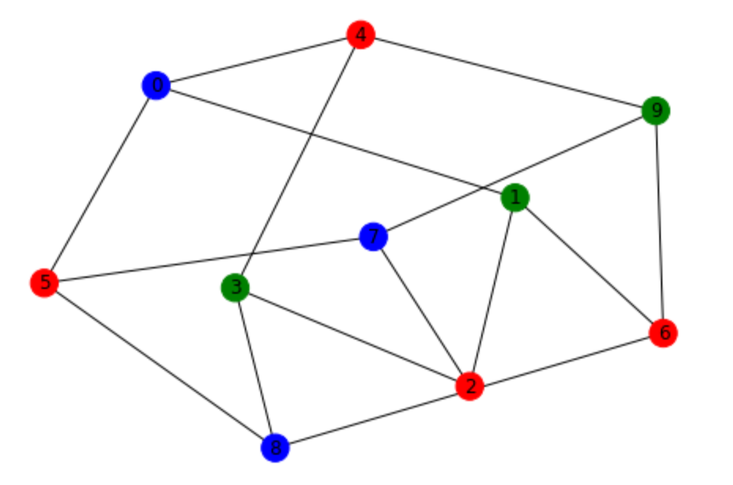
What is 3-GCP?
Put simply, it is finding a way of colouring all the nodes in a graph with 3 colours such that there are no adjacent nodes which share a colour, if possible.
It’s a subsidiary of the k-GCP in which k can be an arbitrary integer.

Slide 4
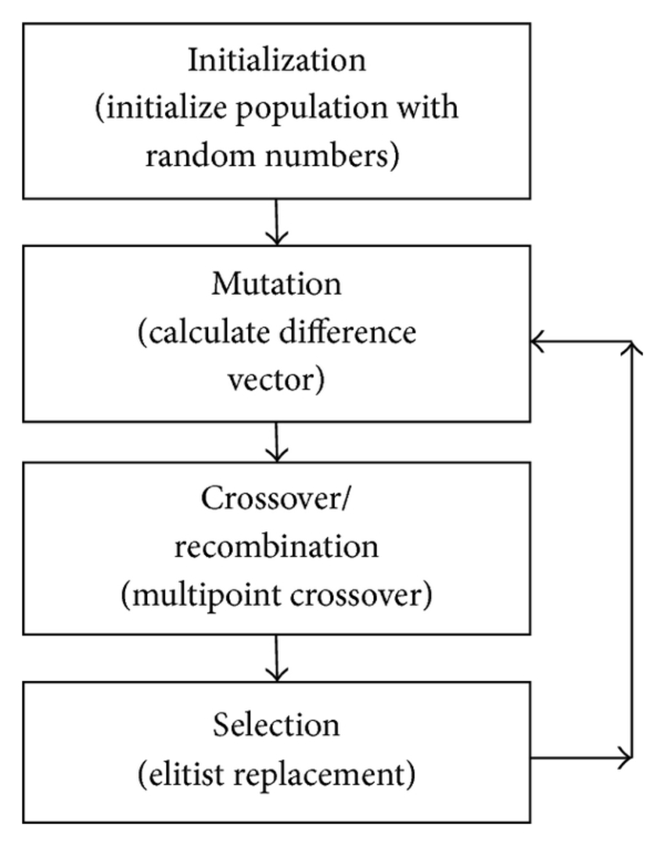
And How About Differential Evolution?
The base algorithm works by doing a linear combination of 3 randomly chosen members of the population in order to determine their velocity.
However there are a number of strategies for such mutation and recombination. The strategy chosen for this project was the ‘best1bin’ strategy, which leads to even faster convergence.
Differential Evolution is a stochastic method for solving real-valued optimisation problems.
It is very quick to converge but this comes with a tradeoff. It is very susceptible to getting caught in a local optimum.

Slide 5
So, What is Best1Bin?
Well, if we break the term down, we get:
Best: We use the best member of the population as a base.
Bin: Short for Binomial, which is the distribution we sample from to determine recombination.

Slide 6
So, What is Best1Bin?
We begin by selecting two random vectors from the population and calling them p0 and p1.

Slide 7
So, What is Best1Bin?
Next we calculate the difference between the two: p0 - p1. And multiply the result by the mutation rate, which we’ll call v.
* mutation rate = v

Slide 8
So, What is Best1Bin?
We’ll then calculate a new vector b’ which is equal to the best member b minus our vector v.
b’ = b - v

Slide 9
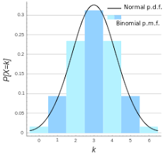
So, What is Best1Bin?
We then choose a random place to start filling our trial vector, and begin sequentially filling (in modulo). For each element we get a number in [0, 1) by using a binomial distribution.

Slide 10
So, What is Best1Bin?
If that number is lower than our recombination constant, we take the element from b’. Otherwise we take it from b. The last element selected is always from b’.

Slide 11
So, What is Best1Bin?
We then compare our trial to our original candidate and if it’s better, it replaces it.

Slide 12
Parameters That Affect the Algorithm
Population Size: the number of candidates to choose from.
Mutation Rate: weighting of randomly selected vectors in calculating b’.
Recombination Constant: likelihood of selecting element from b’ when selecting an element for the trial vector.

Slide 13
Solution Representation and Search Space
Each possible solution is a colouring of the graph. The search space is every possible colouring of the graph with only 3 colours.
We represent each colouring a a vector of node colours where each element is a number 0, 1, or 2. This provides a solution that we can interpret for a 3-GCP.
1
2
2
0
2
1
0
2

Slide 14
Continuous to Discrete
Differential Evolution is designed for Continuous Real-Valued problems.
The 3-GCP Problem is a Discrete Problem.
This is accounted for in the Fitness Function and by Imposing Bounds.

Slide 15
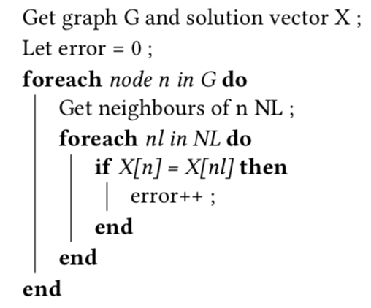
Fitness Function

Slide 16
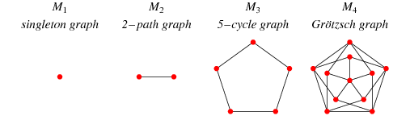
Mycielski Graphs
Graphs, M_{k}, are triangle-free, have chromatic number k, and the graph has the least vertices possible.

Slide 17
Experiments Run
Max Iterations: 100
Graphs: Mycielski 3, 4, 5, and 6
Population Sizes: 5, 10, 15, 20, 25, 30
Mutation Rates: 0.2, 0.35, 0.5, 0.65, 0.8, 0.95
Recombination Constants: 0.2, 0.3, 0.4, 0.5, 0.6, 0.7, 0.8

Slide 18
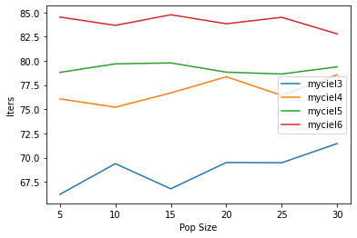
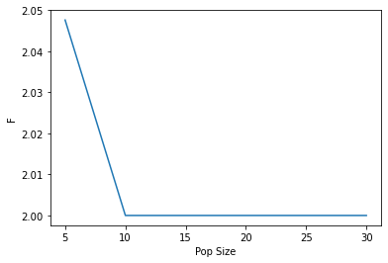
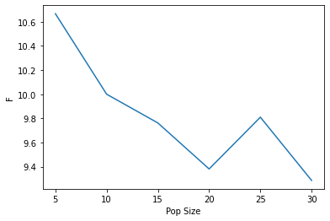
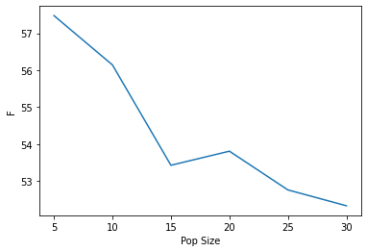
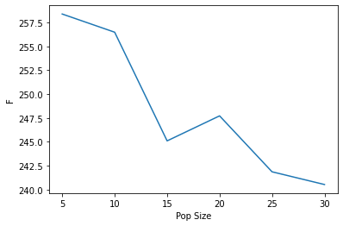
Results: Population Size
It is found that increased population sizes generally leads to better fitness and has very little effect on convergence speed.

Slide 19
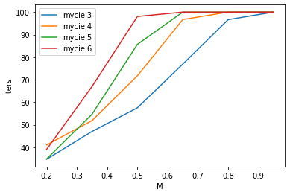
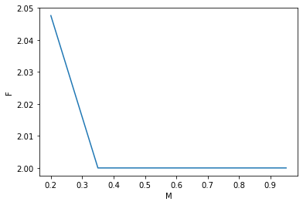
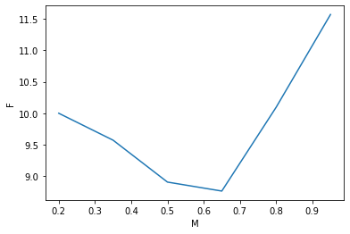
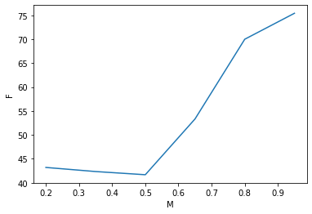
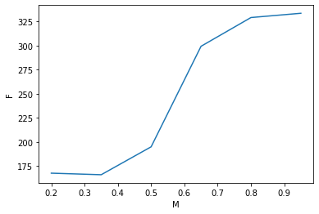
Results: Mutation Rate
Mutation rate increase tends to lead to slower convergence. There is found to be a nice middle-ground where it helps improve fitness but increasing it too much makes the results too random.

Slide 20
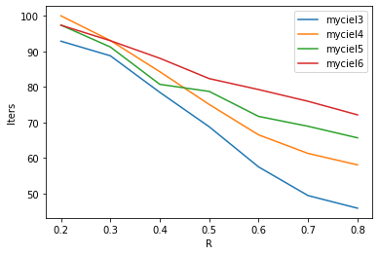
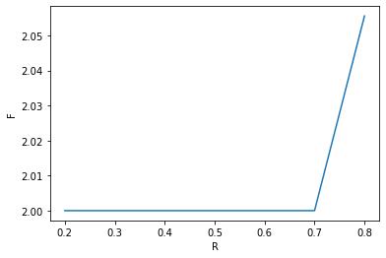
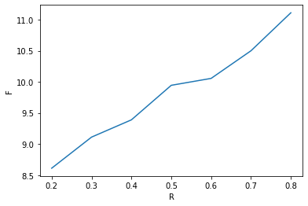
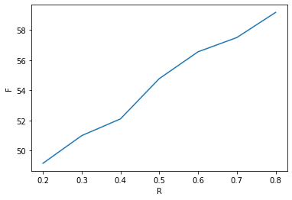
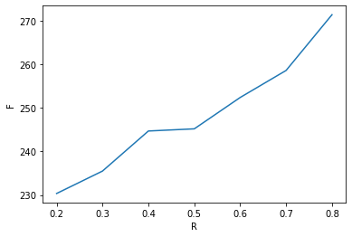
Results: Recombination Constant
Increased recombination constant leads to quicker convergence but worse fitness.

Slide 21
Concluding Remarks

Slide 22
Thanks for Listening

